Slide 1
Fernie Rod & Gun Club WIGWAM FLATS ECOSYSTEM ENHANCEMENT PROJECT 2025-2029

Slide 2
FRGC WFEEP Committee FRGC President: Kevin Marasco Co-chairs: Joe Caravetta / Dave Roberts Committee members: Landon Kubos / Richard Edmundson / Aaron McDonald / George Wilson / Kevin Roberts Project Support: Biodiversity Pathways (Todd Penke / Clayton Lamb)

Slide 3
The Fernie Rod and Gun Club was established in 1899 and is celebrating its 125-year Anniversary. We are the oldest wildlife association in Western Canada and are proud of a long history of our heritage and conservation in the Elk Valley and surrounding areas.

Slide 4
The FRGC is dedicated to the preservation and promotion of sports of shooting, archery, hunting and fishing. The club seeks to maximize hunting and fishing opportunities while encouraging a healthy and sustainable environment. This includes the enhancement of wildlife habitat. It is the mission of the club to enhance and maintain an environment in which populations of wildlife can thrive.

Slide 5
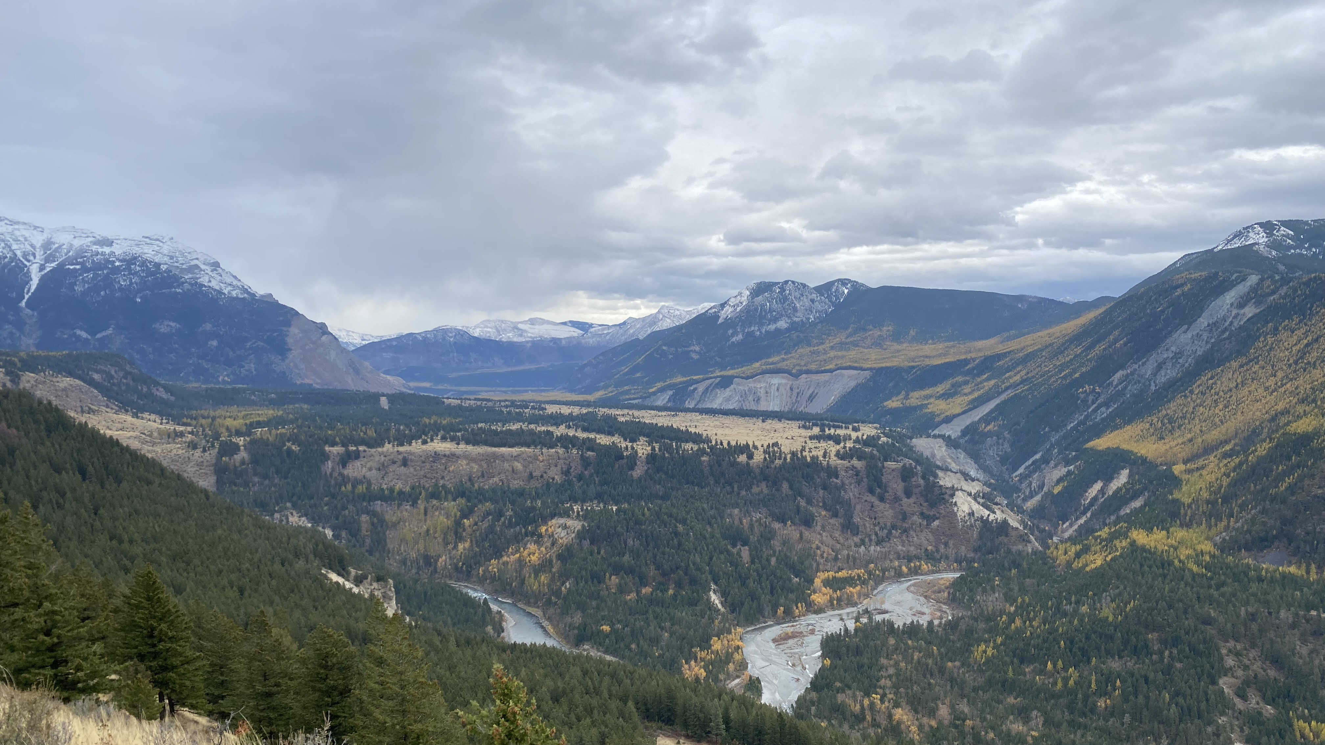
The FRGC has been involved with habitat conservation for many decades and has performed numerous projects in the Wigwam Flats area over the years and continues to this day. In 2010 the Club won the Roderick Haig-Brown Memorial Conservation Award for the extensive work done on the “Wigwam River Flats Restoration Project”

Slide 6
.
The Club’s vision is to preserve this land for many years by continuing a legacy of habitat conservation and taking a big step with Columbian Basin Trust and partners/friends of the lands.
This is how the FRGC Wigwam Flats Ecosystem Enhancement Project came to be..

Slide 7
We are happy to announce that the Club’s “Wigwam Flats Ecosystem Enhancement Project” has been approved by the Columbia Basin Trust to move to the final step in the application process.

Slide 8
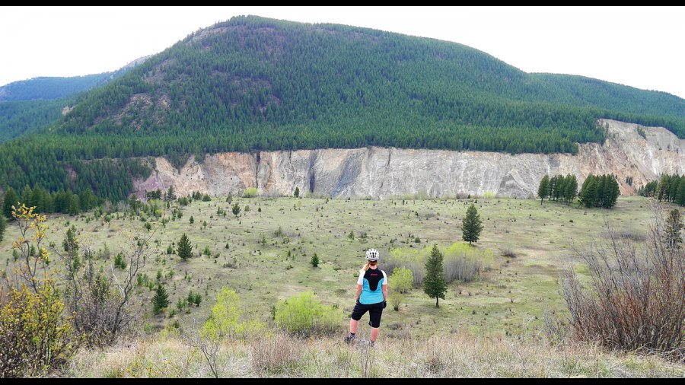
Wigwam Flats is a well-known area to residents and visitors of the Elk Valley and for local First Nations. There are thousands of visitors to this area for hiking, swimming, biking, bird/wildlife viewing, taking in the incredible scenery, as well as fishing and hunting.
Image courtesy of ferniefix.com

Slide 9
All of the communities in the Elk Valley and south to Jaffray, Baynes Lake, Bull River, Cranbrook, and Kimberley have special ties to this area. The support the FRGC has received in the past with small projects in this area has been amazing. With the magnitude and scope of this new project we are humbled by the amount of people and organizations that want to be a part of it. This will be the beginning of a new era of habitat enhancement, and we are very excited to get this project to the next stage and commence work.
Image courtesy of ferniefix.com

Slide 10
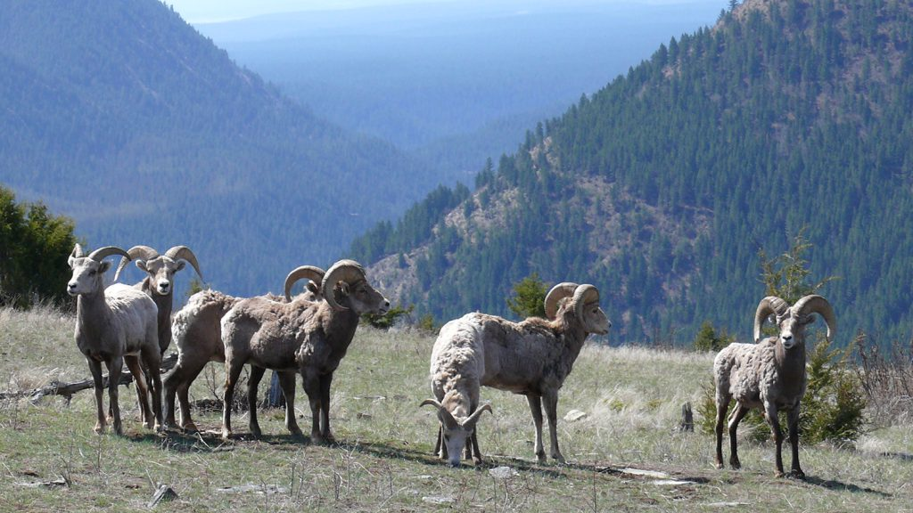
There are very few areas in North America where you will find the following species living in the same area…
Bighorn Sheep
Elk
Mule deer
Whitetail deer
Moose
Mountain goats
Grizzly bears
Black bears
Wolves
Coyotes
Cougars
Wolverines
Badgers
Lynx
Bobcats
Racoons
Skunks
Porcupines
Rabbits
Ground squirrels
Dozens of bird species

Slide 11
Unfortunately, forest and invasive weed encroachment have reduced the amount and quality of habitat for critical ungulate species
Wigwam Flats – circa 1950s
Wigwam Flats – recent
The WFEEP will restore hundreds of hectares of land through slashing, spraying, and seeding over the next 5yrs. Wildlife and habitat studies will monitor project effectiveness, evaluating habitat quality and relative ungulate abundance.
The project has been designed and will be completed with close partnerships with (among others):

Slide 12
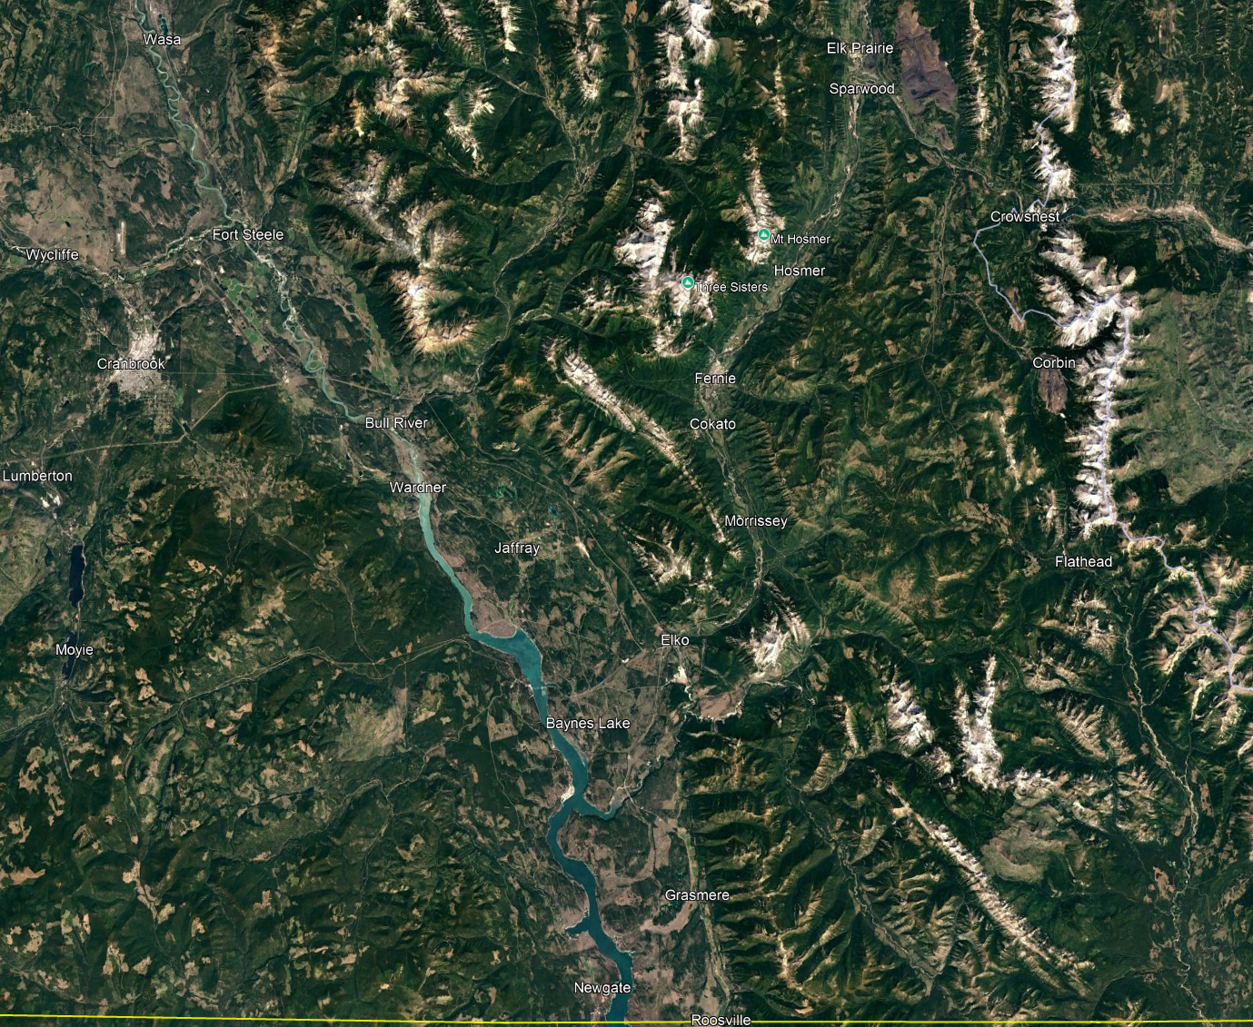
Project Area
The Wigwam Flats/Mt.Broadwood Conservation Area is located approximately 42kms south of Fernie
The subject area is in a 1300-hectare parcel that has different landscape features.
Most of the parcel will be on flat land that is easily accessible by foot.
Land managers include Nature Conservancy of Canada, Nature Trust BC, Province of BC, and Yaq̓it ʔa·knuqⱡi ‘it First Nation.
The area serves as critical winter range from the surrounding mountains to it’s north and west

Slide 13
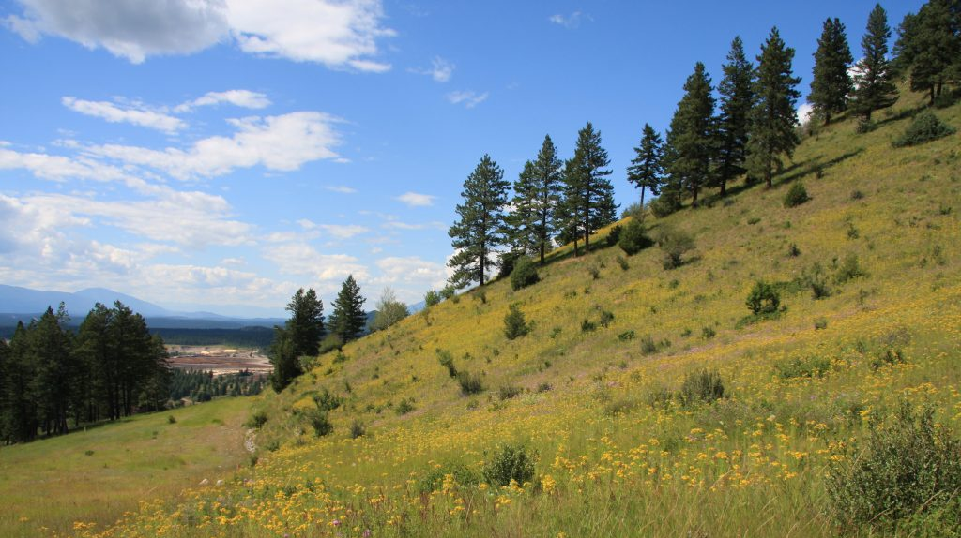
Employment benefits for the community
We plan to hire a project manager to oversee the 5-year effort
CBT also offers to cover 50% of two students’ wages for the project. This will be a great opportunity to hire two local youths specializing in the habitat management field.
Numerous contract opportunities for slashing and invasive weed work (note extensive St. Johns-Wort in pic)
Image courtesy of hctf.ca

Slide 14
Employment benefits for the community
We plan to hire a project manager to oversee the 5-year effort
CBT also offers to cover 50% of two students’ wages for the project. This will be a great opportunity to hire two local youths specializing in the habitat management field.
Numerous contract opportunities for slashing and invasive weed work (note extensive St. Johns-Wort in pic)
Proposed Work
Ground proofing
Site prescriptions
Thinning of conifer ingrowth
Sightline improvement,
Invasive weed treatment (seeding, fertilizing),
Project evaluation (e.g., vegetation plot monitoring, drone coverage pre/post, review of wildlife telemetry data)
Image courtesy of hctf.ca

Slide 15
Employment benefits for the community
We plan to hire a project manager to oversee the 5-year effort
CBT also offers to cover 50% of two students’ wages for the project. This will be a great opportunity to hire two local youths specializing in the habitat management field.
Numerous contract opportunities for slashing and invasive weed work (note extensive St. Johns-Wort in pic)
The main objective is to improve habitat for critical and ungulate species (ie. Elk, bighorn sheep, mule deer, whitetail, moose) and will focus on improving the amount of quality of forage and improving sightlines for predator avoidance.
Image courtesy of hctf.ca

Slide 16
To identify the highest priority areas for actions, we will coordinate closely with the local provincial habitat team, led by Allana Oestreich, Yaq̓it ʔa·knuqⱡi ‘it lands and resources, and other parties.
We will compare already developed prescriptions and compare to on-the-ground conditions and review relevant wildlife data

Slide 17
The projected budget for the 5-year project is $1,239,000 with Columbia Basin Trust providing up to $750,000, dependent on approval of final application.
The FRGC is committing $25,000 over the next 5 years. Reception of the full CBT grant requires closing the funding gap.

Slide 18
Our current shortfall for the project is $464,000 and we are requesting financial support so we can move forward with the largest Wildlife Habitat Enhancement Project that has ever happened in the area.
Partnering with the FRGC will show the commitment in continuing the enhancement of critical landscape for the wildlife and people of the greater Elk Valley.

Slide 19
In summary we are looking to give back to the land and wildlife by addressing what has been changing due to human activities. We have a chance to improve this special place for future generations.
We must all work together for this project to work… communities and associations, the resource sector, Indigenous communities, hunters, fisherpersons, hikers, bikers, environmentalists alike. It is time to band together to do our part for the environment.
The FRGC and WFEEP Committee are excited to have you as a partner is this amazing adventure!!

Slide 20
Thank You For Your Support!
Please contact our committee at president@ferniergc.com with questions, inquiries, funding and partnerships.
Cheques can be made out to the FRGC Wigwam Flats Ecosystem Enhancement Project. E-transfers available – please contact Kevin at president@ferniergc.com for more information.
Thank You

